Slide 1


As Simple as 1-2-3
Sunny Modules

Slide 2
Sunny Modules
Copyright ©2022 iSystem Asia All rights reserved.

Slide 3

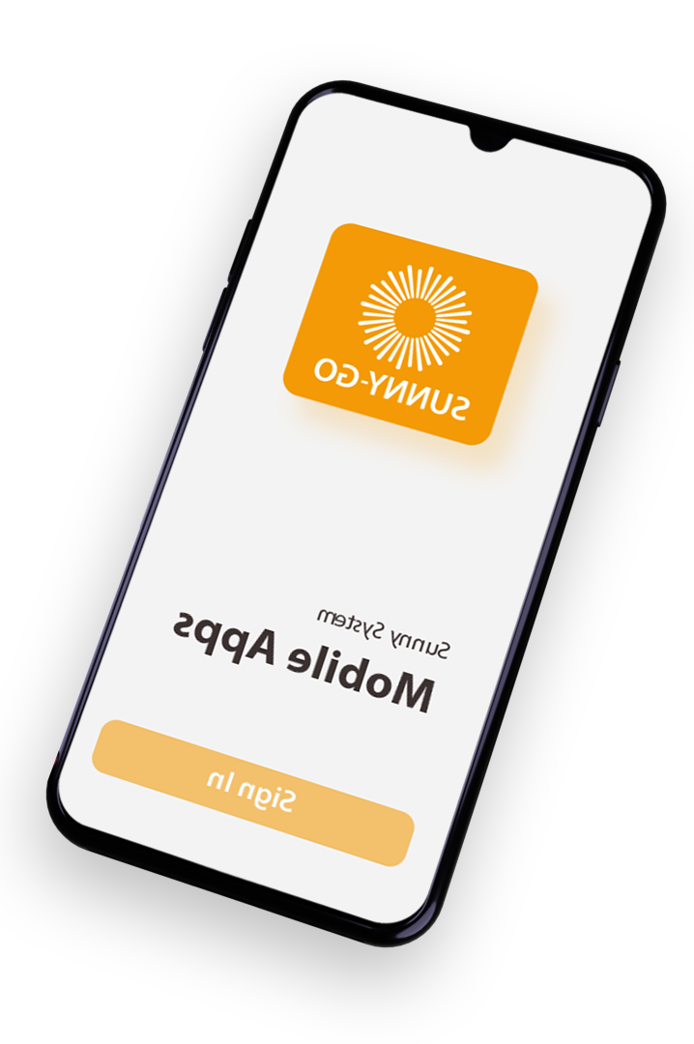

Sunny Modules
Sunny Marketing
Sunny Sales
Sunny Services
Sunny Customer 360
Sunny Dashboard Analytics
Sunny Document Management System
Sunny Project Management
Sunny RPA
Sunny Portal
Sunny AI Face Recognition

Slide 4
Sunny Modules
Copyright ©2022 iSystem Asia All rights reserved.

Slide 5
Sunny Modules
Sunny Marketing
Sunny Sales
Sunny Services
Sunny Customer 360
Sunny Dashboard Analytics
Sunny Document Management System
Sunny Project Management
Sunny RPA
Sunny Portal
Sunny AI Face Recognition

Slide 6
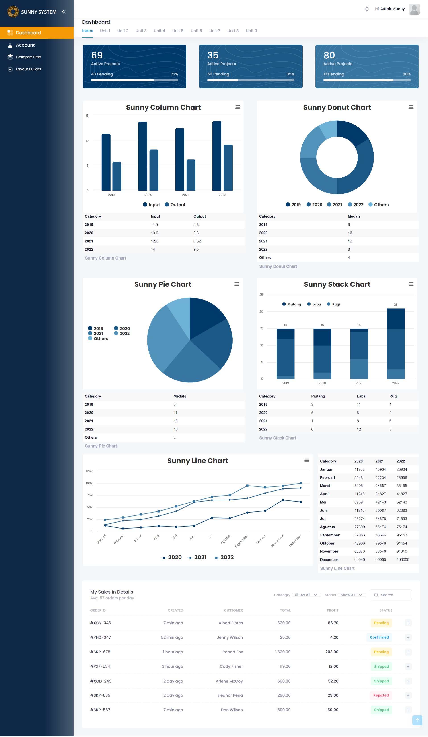
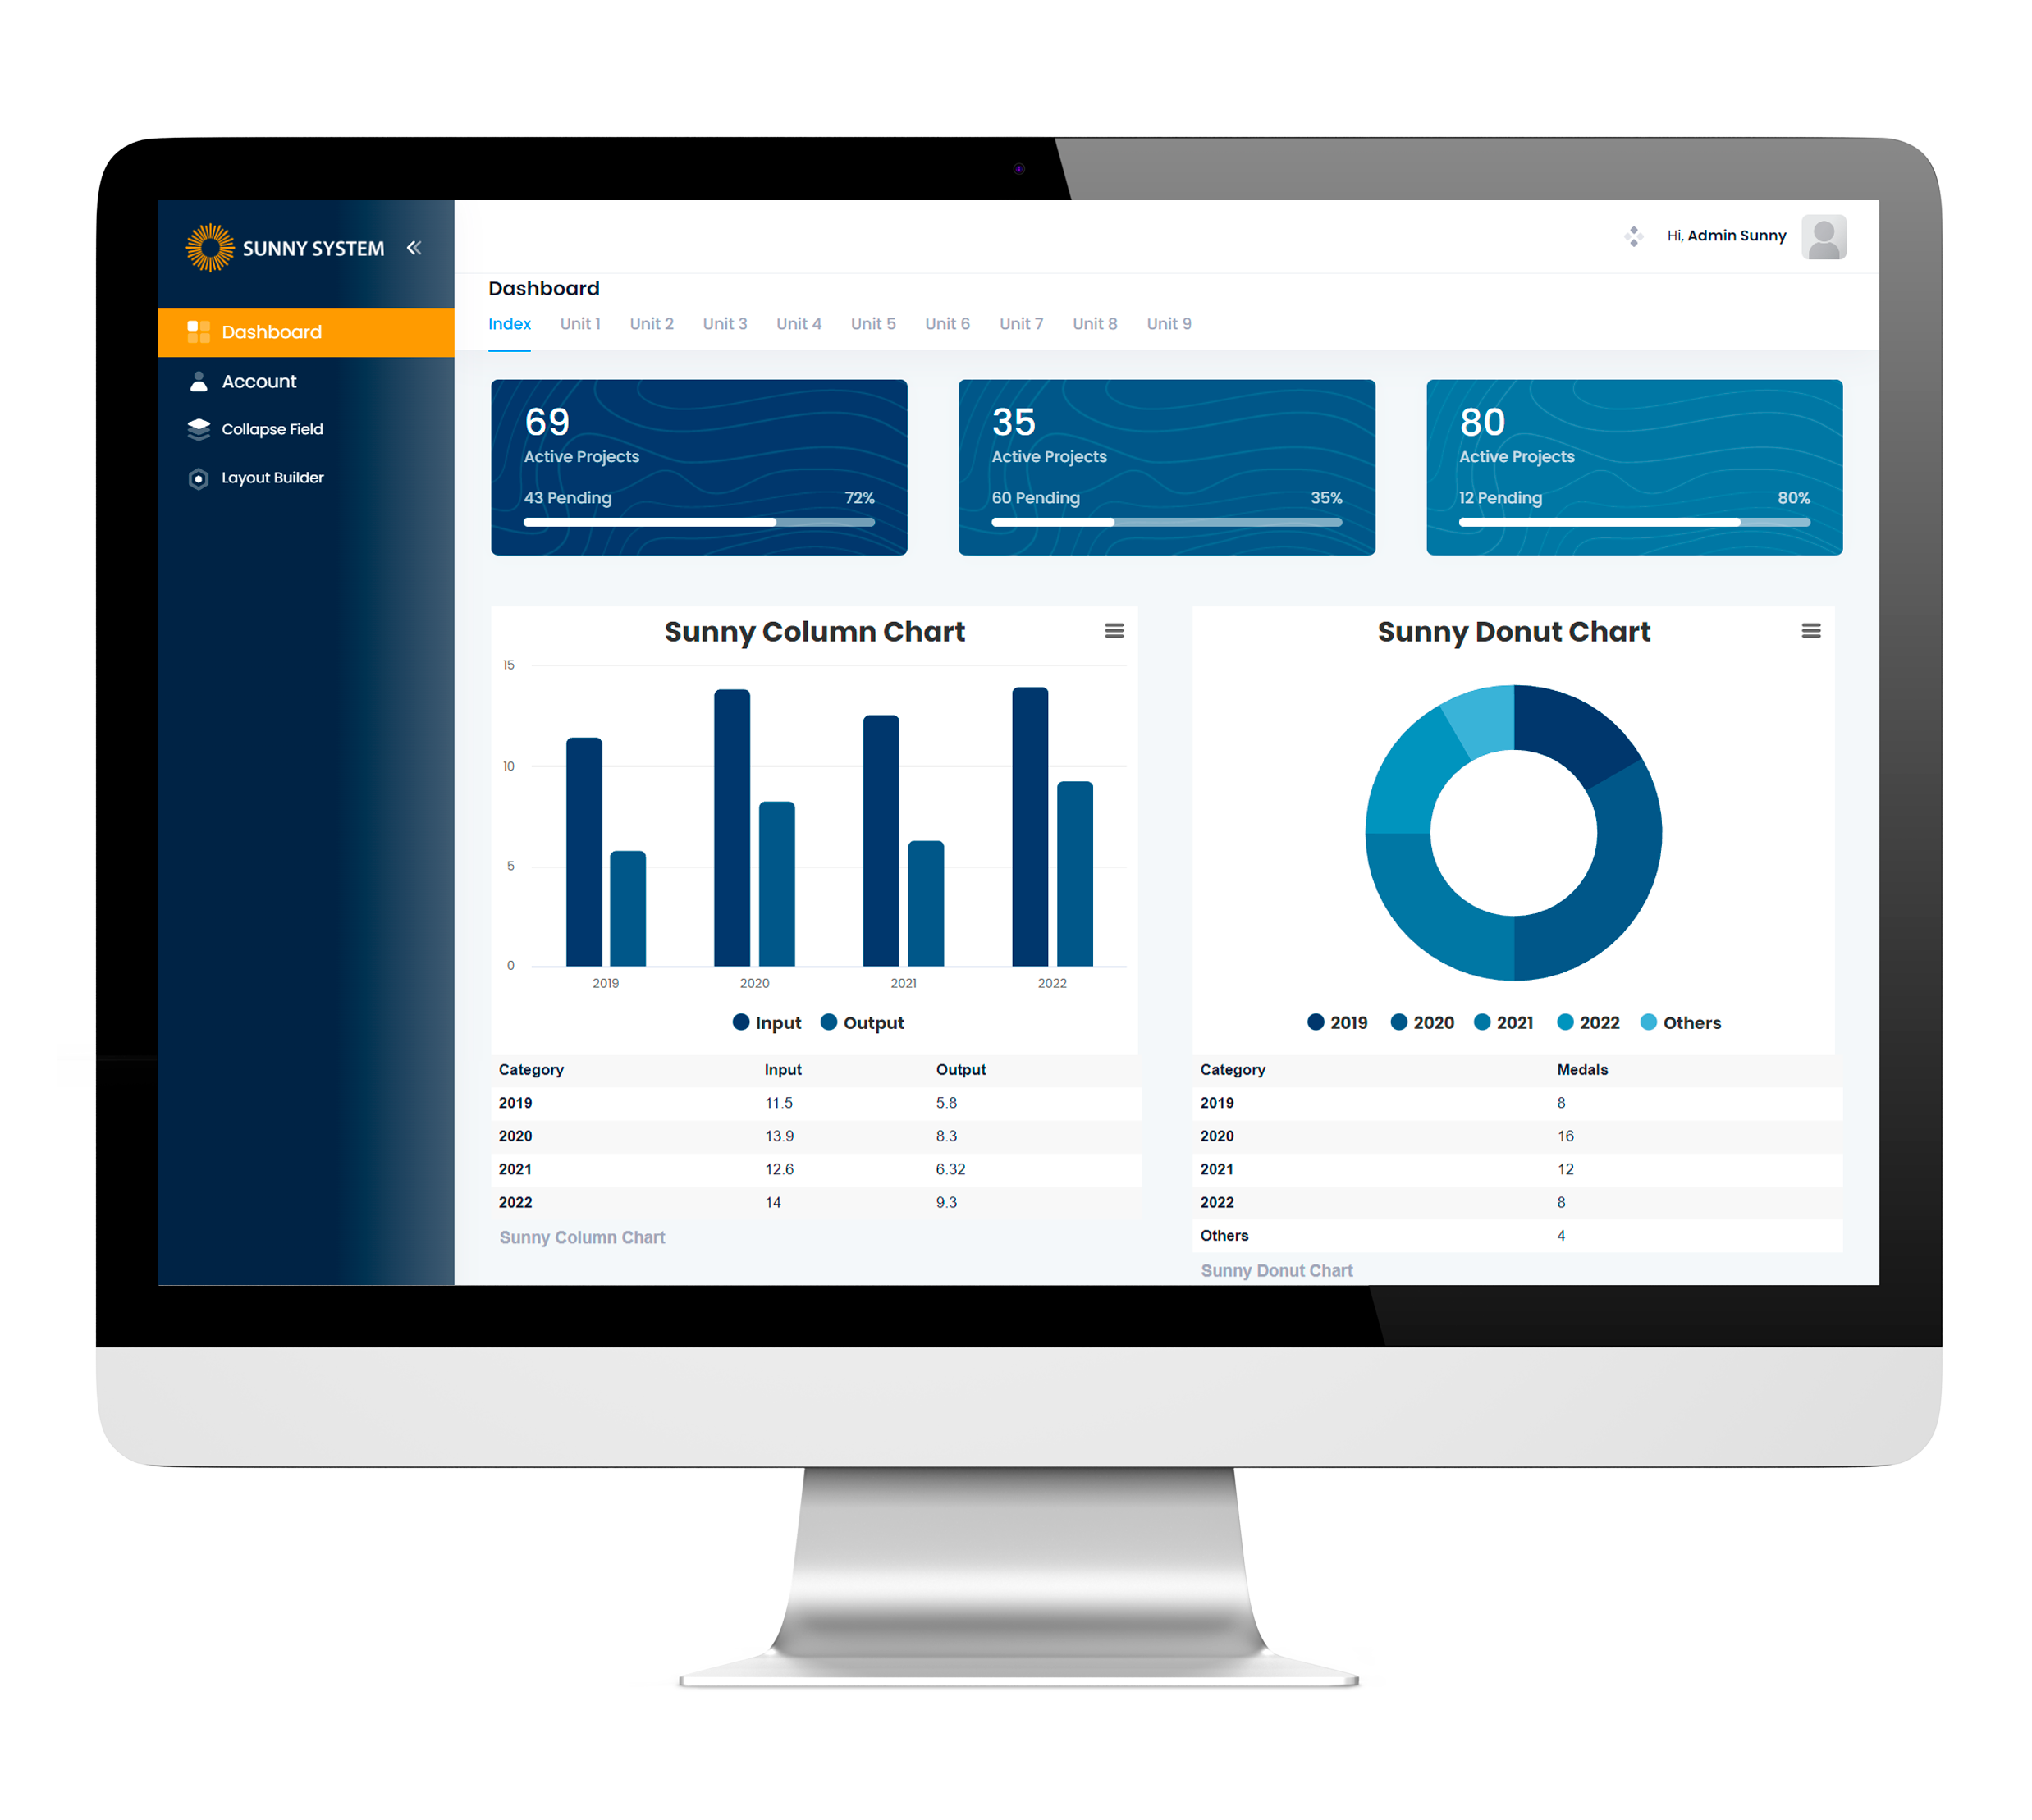
Sunny Dashboard Analytics

Slide 7
Sunny Dashboard Analytics

Slide 8
^{THANK YOU!}
Sunny Systems
(PT Sani Mentari Indonesia)
Arkadia Green Park Estate, Tower F, 6th Floor
Jl. TB Simatupang Kav. 88, Jakarta 12520 - Indonesia
Hotline: +62 21-7883 3022 / 7883 8714
hi@sunny.co.id | www.sunny.co.id
Copyright © 2022 Sunny - All rights reserved

